Slide 1
Intelligent Claims Registration using Azure Cognitive Services
Supervised Machine Learning models for Document Analysis - Azure Document Intelligence
SE ZG628T: Dissertation
by Jojo Thomas [2021mt93554]

Slide 2
Contents
Steps for training models in Azure Document Intelligence
Create Resource Group
Create Document Intelligence Resource
Create Storage Account
Create Blob Storage
Create Custom Model
Label Data
Train Data
Compose Models
Test Models

Slide 3
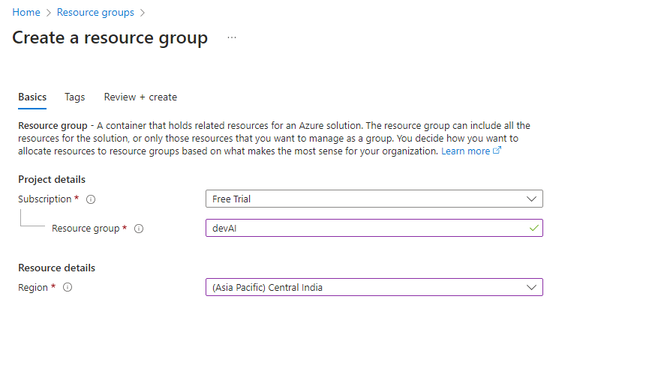
Create Resource Group

Slide 4
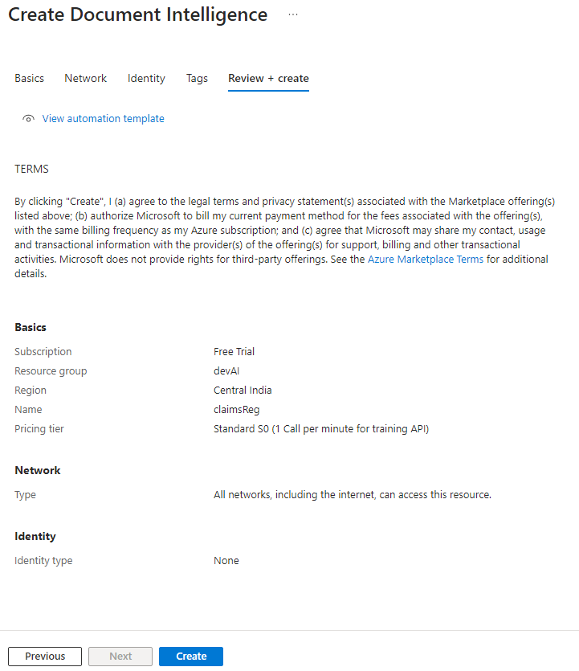
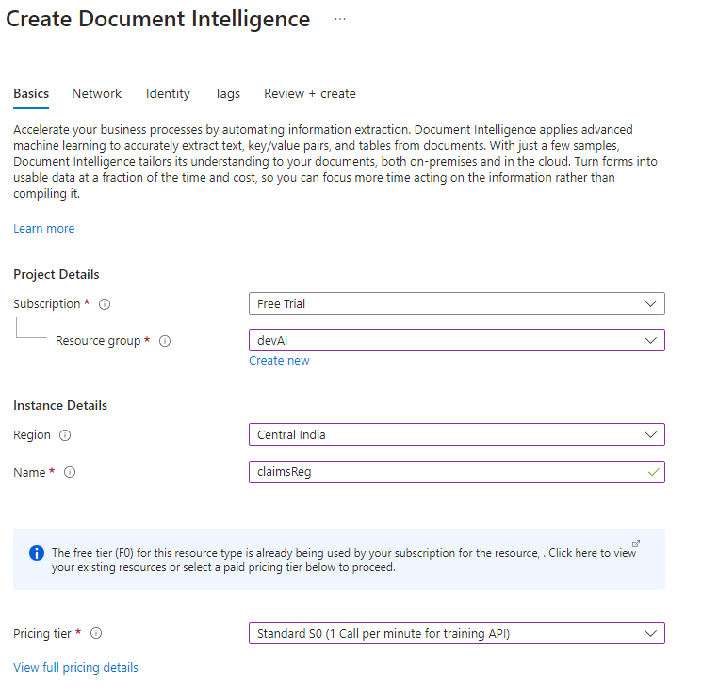
Create Document Intelligence Resource

Slide 5
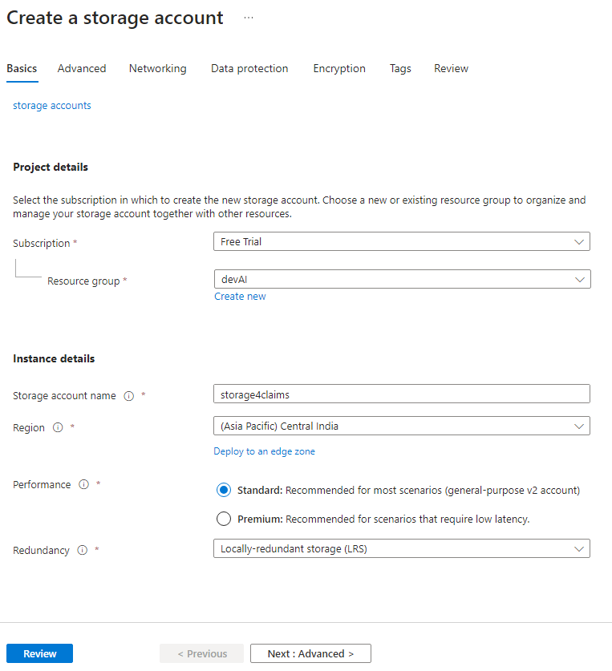
Create Storage Account

Slide 6
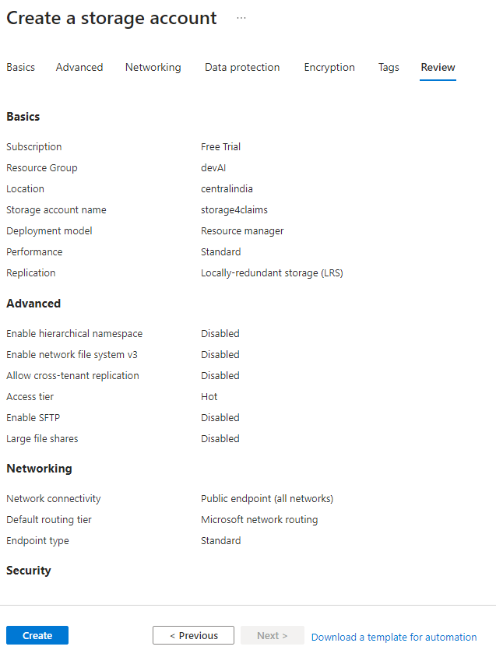
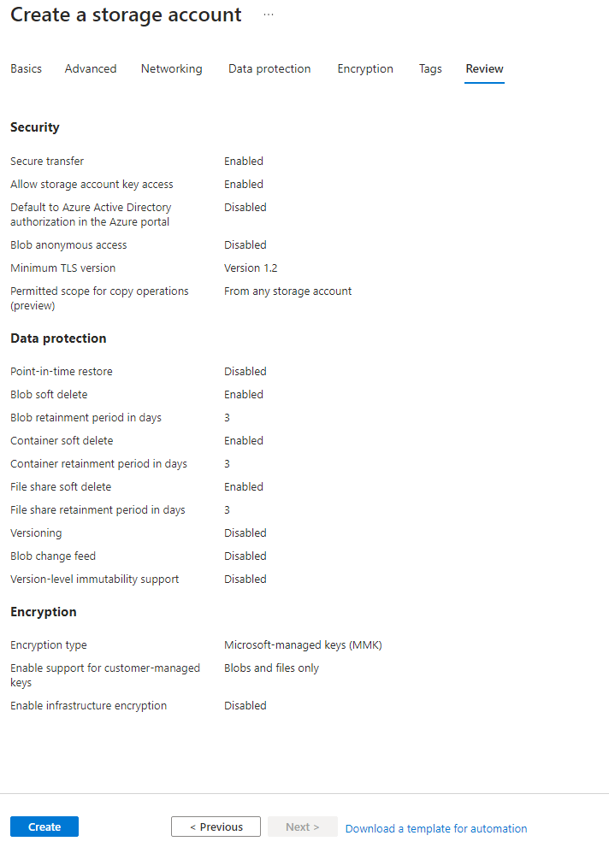

Slide 7
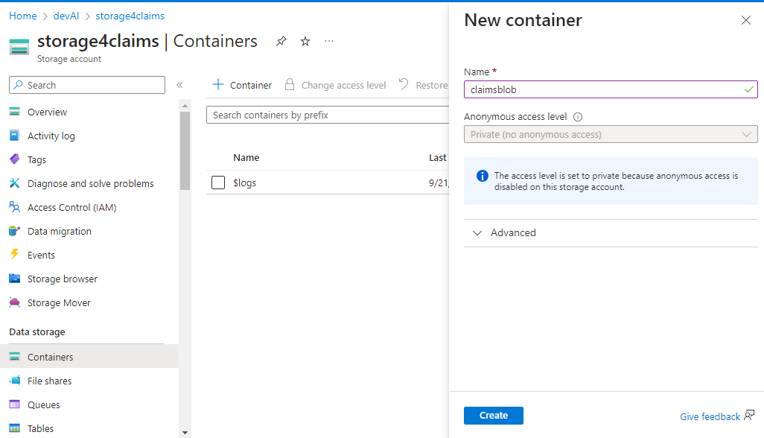
Create Blob Storage

Slide 8
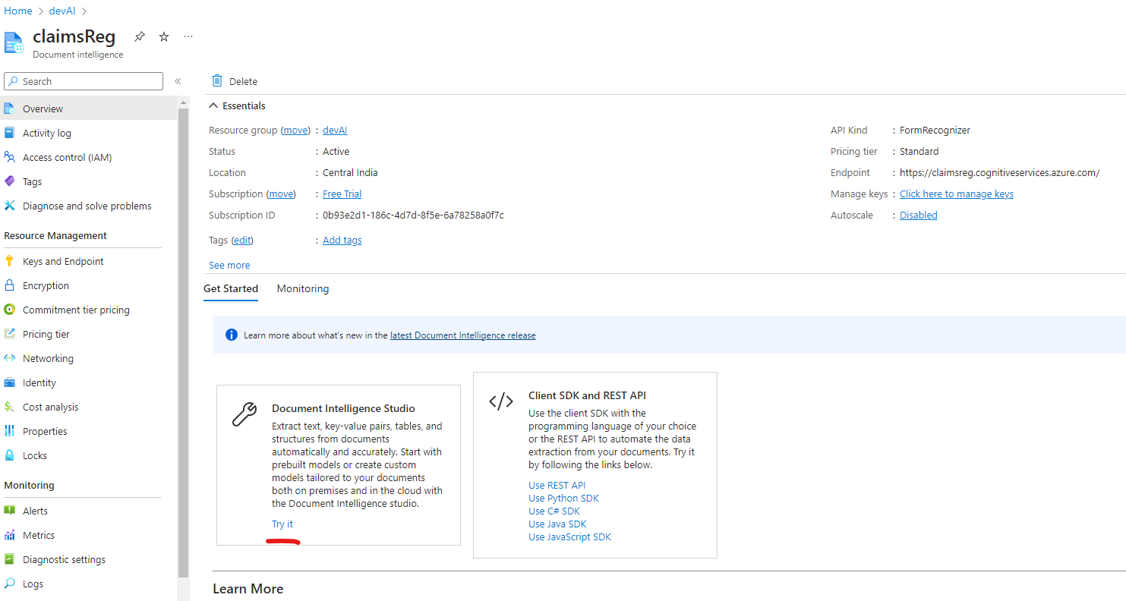
Create Custom Model

Slide 9
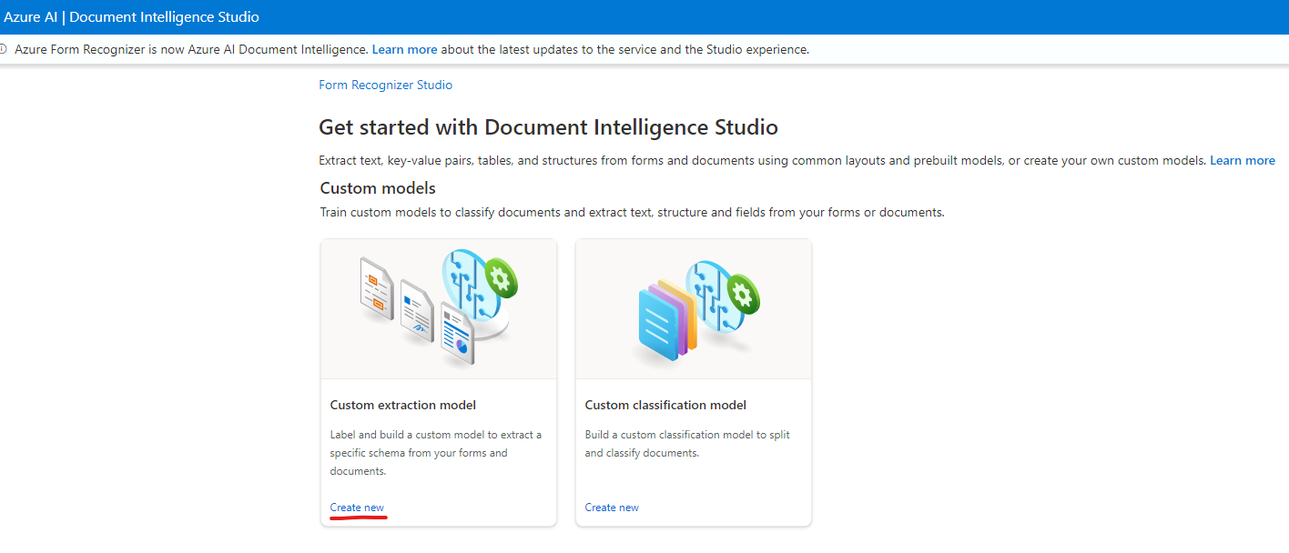

Slide 10
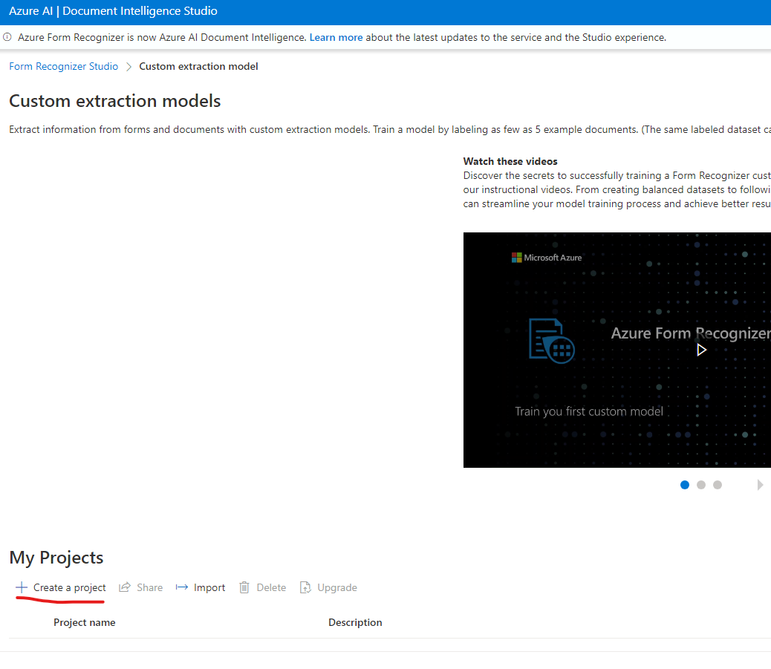

Slide 11
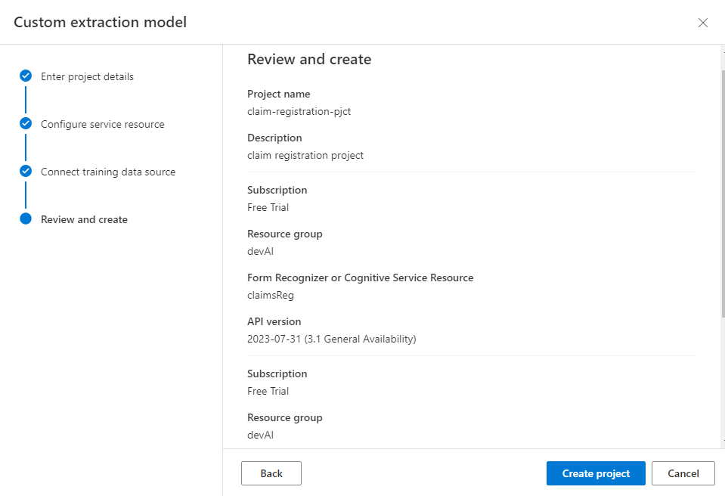

Slide 12
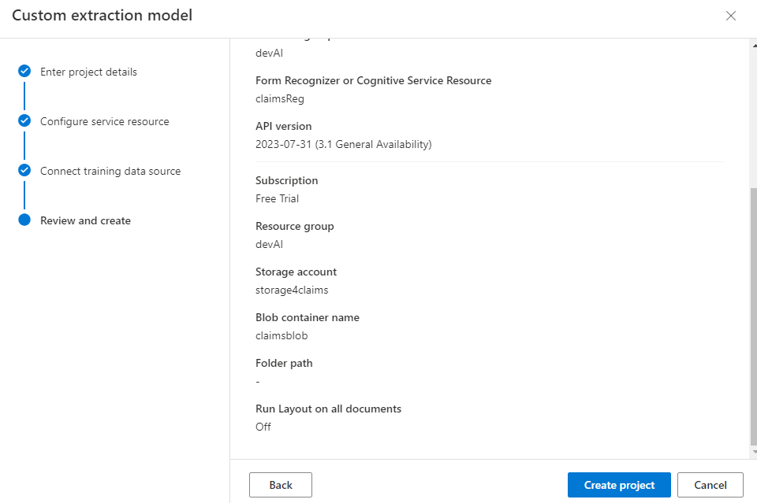

Slide 13
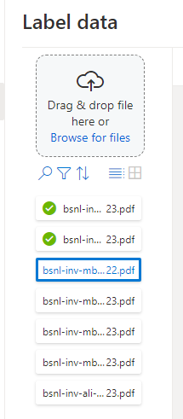
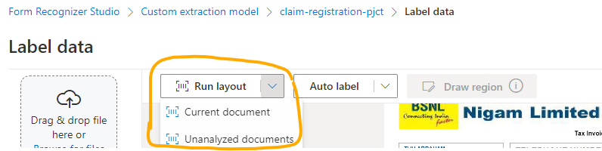
Label Data

Slide 14
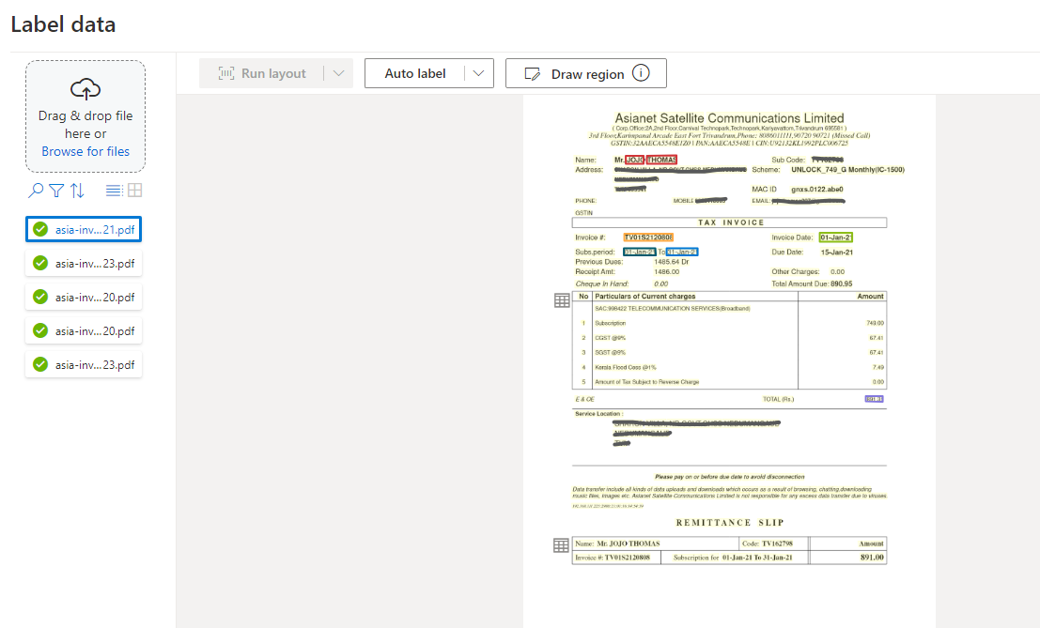

Slide 15
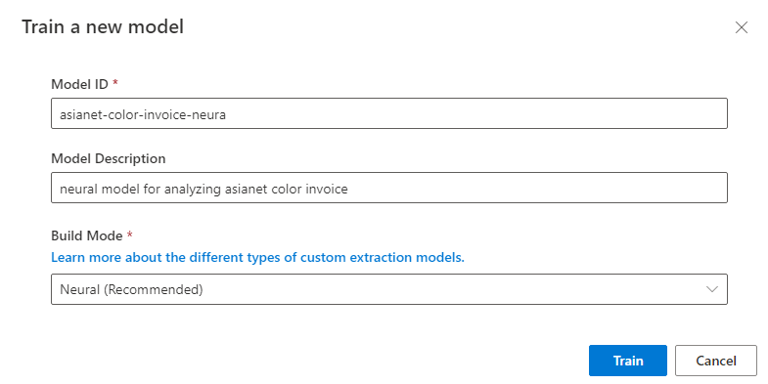
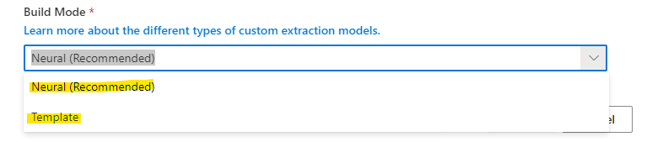
Train Data

Slide 16
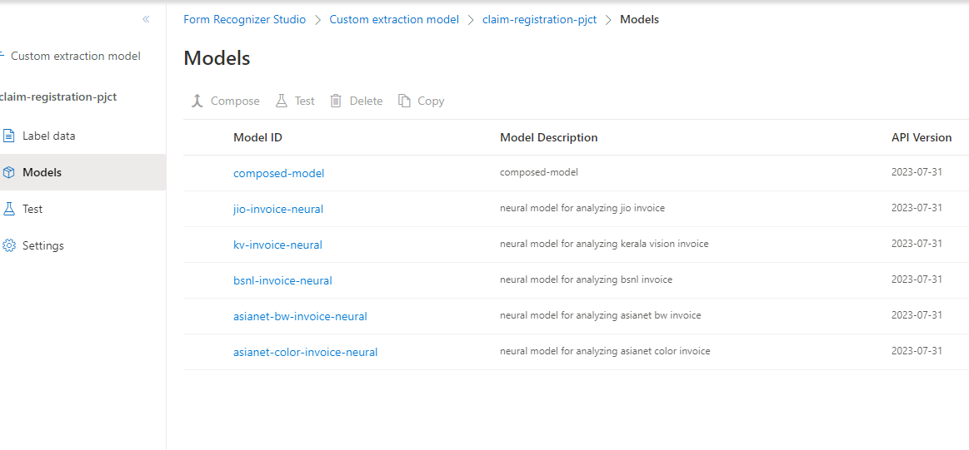
Trained Models

Slide 17
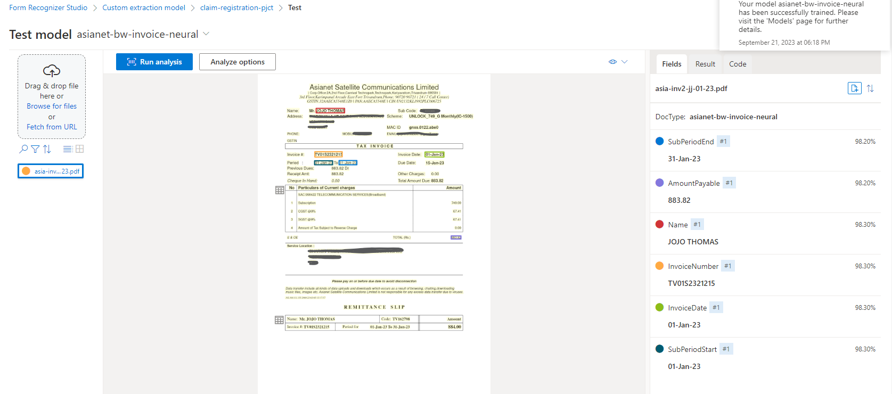
Test Models

